Slide 1

Gen AI
Course Code:25ECSC307
Team D7
Public Transport Delay Explainer and Alternate Route Advisor
Guide : Dr. Guruprasad K
Name | Roll No | USN
Chinmayi K B | 412 | 01FE23BCS080
Ananya B Pattanashetty | 406 | 01FE23BCS055
Srishti Manvi | 403 | 01FE23BCS045
Rashmi M Mathapati | 419 | 01FE23BCS300

Slide 2
Problem statement
To develop an AI-powered public transport delay explanation and alternate route advisory system that provides real-time passenger communication, multilingual announcements, and route recommendations.
Objectives
Generate AI-powered passenger announcements explaining transport delays based on route, cause, and delay duration.
Provide multilingual communication and voice outputs in English and Kannada for better accessibility.
Recommend optimized alternate routes using Dijkstra’s Algorithm and generate incident reports for efficient passenger information management.

Slide 3
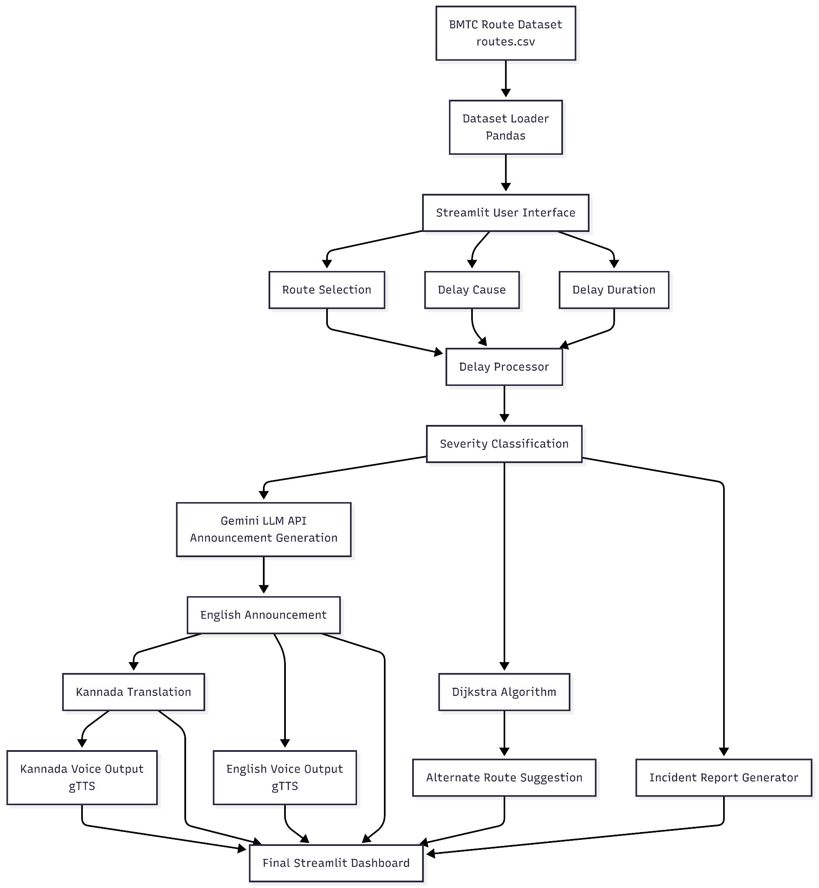
Architecture

Slide 4
Thank You

